Slide 1

Analysis of Anti-Dumping Policy on Steel Imports Using Multi-Input ARIMA Intervention Model
Authors:
Prisita Nallavasthi
Siskarossa Ika Oktora
Politeknik Statistika STIS, Jakarta

Slide 2
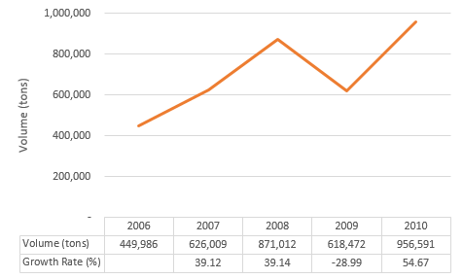
Introduction
Krakatau Steel has been in loss for several years.
Indonesian CRC/S Import Volume
Positive trend and high growth rate in import.
Low price with better quality in imported steel.
Suspiciousness in dumping activity

Slide 3
Introduction
Japan, South Korea, China, Taiwan, Vietnam have proven to do dumping activity
Anti-dumping policy ended
Krakatau Steel filed an anti-dumping petition
March
2016
June
2011
March
2013
Initiation of investigation by KADI
Anti-dumping policy applied
Peraturan Menteri Keuangan No. 65/PMK.011/2013

Slide 4
Literature Review
Title | Author(s) | Information
Invisible Trade Barriers: Trade Effects of US Antidumping Actions Against the People’s Republic of China | Lee, Park, and Cui (2013) | Anti-dumping is able to reduce import from subjected AD duties country
Estimating The Impact of Anti‐Dumping and Anti‐Cartel Actions Using Intervention Analysis | Llyod, Morrisey, and Reed (1998) | Intervention analysis can be used to estimate the impact of anti-dumping and it is relatively simple
Modelling The Impact of Government Policies on Import on Domestic Price of Indian Gold Using ARIMA Intervention Method | Unnikrishnan and Suresh (2016) | ARIMA intervention produces a better model to know the impact of policy application than other methods
Analysis of The Effect of Fuel Price Policy on Jakarta Inflation by Using Multi-Input Intervention Model | Sohibien (2018) | The impact of changes in fuel prices on inflation
Multi Input Intervention Model for Evaluating the Impact of The Asian Crisis and Terrorist Attacks on Tourist Arrivals | Lee, Suhartono, and Sanugi (2010) | The impact of terrorist attack on tourist arrival.

Slide 5
Research Framework
Investigation by KADI since June 2011
Application of anti-dumping policy since March 2013
CRC/S Import Volume from South Korea, China, and Taiwan
Expiration of anti-dumping policy since March 2016
Multi Input ARIMA Intervention (3 steps function)

Slide 6
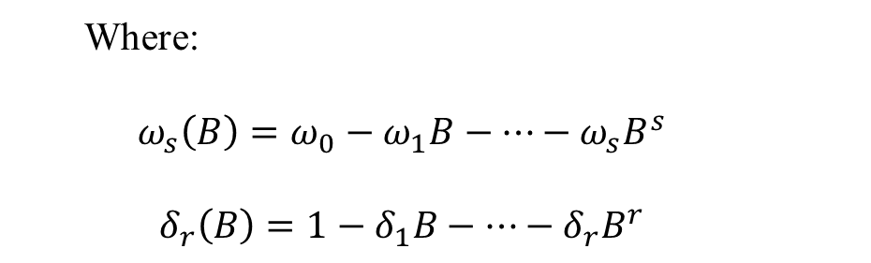
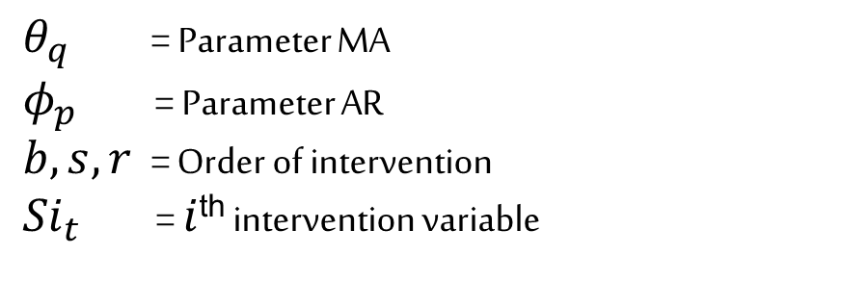
Methods
ARIMA Intervention
$$Y_{t}=\frac{ω_{s}\left(B\right)B^{b}}{\left.δ_{r}(B\right)}{S1}_{t}+\frac{ω_{s}\left(B\right)B^{b}}{\left.δ_{r}(B\right)}{S2}_{t}+\frac{ω_{s}\left(B\right)B^{b}}{\left.δ_{r}(B\right)}{S3}_{t}+\frac{θ_{q}\left(B\right)u_{t}}{φ_{p}\left(B\right)}$$
Where:
$$ω_{s}\left(B\right)=ω_{0}−ω_{1}B−…−ω_{s}B^{s}$$
$$δ_{r}\left(B\right)=1−δ_{1}B−…−δ_{r}B^{r}$$
$θ_{q}$ = Parameter MA
$φ_{p}$ = Parameter AR
$b,s,r$ = Order of intervention
${Si}_{t}$= $i$^{th} intervention variable

Slide 7
Methods
ARIMA Intervention
Pre-intervention
First intervention
Second Intervention
Third Intervention

Slide 8
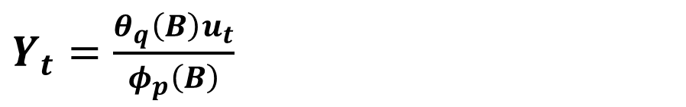
Methods
ARIMA Intervention
Pre-intervention
First Intervention
Second Intervention
Third Intervention
Stationarity test
Model identification
Parameter Estimation
Diagnostic test
ARIMA
$Y_{t}=\frac{θ_{q}\left(B\right)u_{t}}{φ_{p}\left(B\right)}$

Slide 9
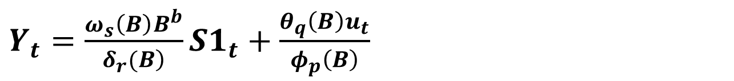
Methods
ARIMA Intervention
First Intervention
Second Intervention
Third Intervention
Pre-intervention
-RMSE-
ARIMA 1st Intervention
Residual
$Y_{t}=\frac{ω_{s}\left(B\right)B^{b}}{\left.δ_{r}(B\right)}{S1}_{t}+\frac{θ_{q}\left(B\right)u_{t}}{φ_{p}\left(B\right)}$

Slide 10
Methods
ARIMA Intervention
Second Intervention
Third Intervention
Pre-intervention
First Intervention
ARIMA 1st Intervention
ARIMA 2nd Intervention
-RMSE-
Residual
$Y_{t}=\frac{ω_{s}\left(B\right)B^{b}}{\left.δ_{r}(B\right)}{S1}_{t}+\frac{ω_{s}\left(B\right)B^{b}}{\left.δ_{r}(B\right)}{S2}_{t}+\frac{θ_{q}\left(B\right)u_{t}}{φ_{p}\left(B\right)}$
RMSE

Slide 11
Methods
ARIMA Intervention
Third Intervention
Pre-intervention
First Intervention
Second Intervention
ARIMA 2nd Intervention
ARIMA Final Intervention
-RMSE-
Residual
$Y_{t}=\frac{ω_{s}\left(B\right)B^{b}}{\left.δ_{r}(B\right)}{S1}_{t}+\frac{ω_{s}\left(B\right)B^{b}}{\left.δ_{r}(B\right)}{S2}_{t}+\frac{ω_{s}\left(B\right)B^{b}}{\left.δ_{r}(B\right)}{S3}_{t}+\frac{θ_{q}\left(B\right)u_{t}}{φ_{p}\left(B\right)}$
RMSE

Slide 12
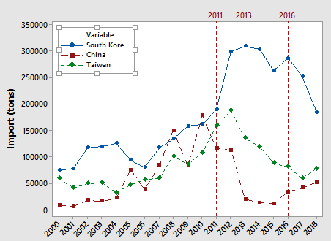
Result Indonesian CRC/S Import
Indonesian CRC/S Annual Imports
CRC/S Import by Country Origin

Slide 13
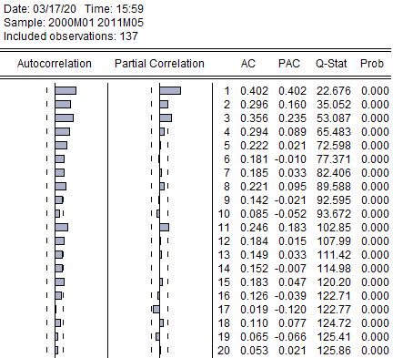
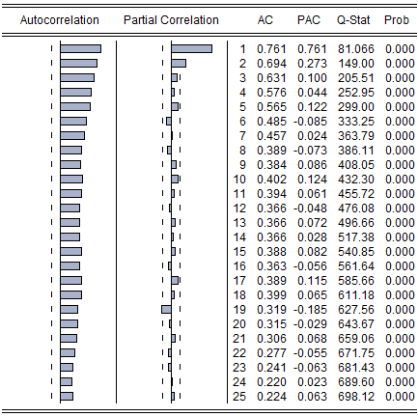
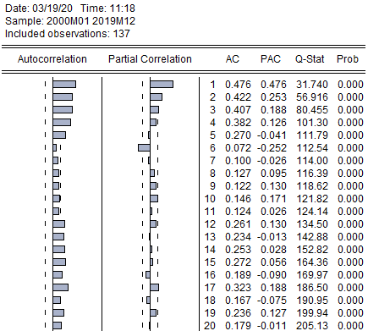
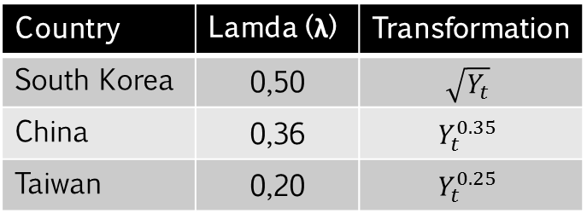
Result Stationarity Test and Model Identification
Variance Stationarity
Country | Lamda (λ) | Transformation
South Korea | 0,50 | $$\sqrt{Y_{t}}$$
China | 0,36 | $$Y_{t}^{0.35}$$
Taiwan | 0,20 | $$Y_{t}^{0.25}$$
Mean Stationarity
Country | P-value
South Korea | 0,00
China | 0,00
Taiwan | 0,00
South Korea
China
Taiwan

Slide 14
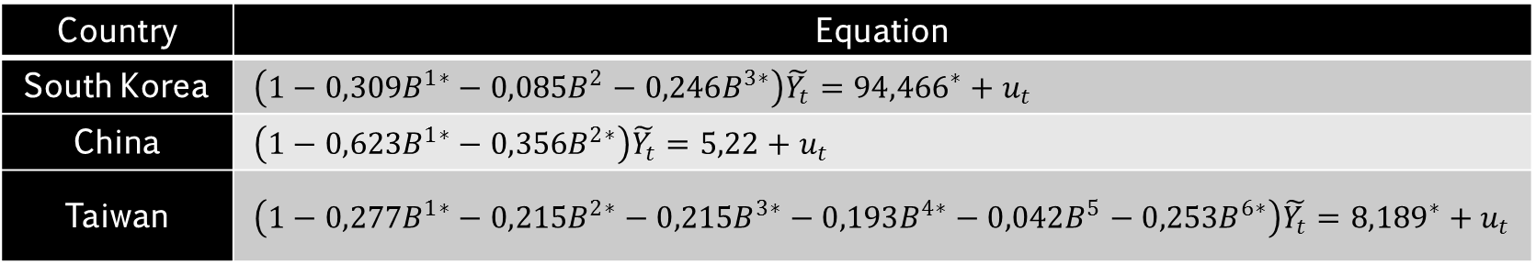
Result ARIMA Pre-Intervention Model
Country | Equation
South Korea | $\left(1−{0,309B}^{1∗}−{0,085B}^{2}−{0,246B}^{3∗}\right)\tilde{Y_{t}}={{94,466}^{∗}+u}_{t}$
China | $\left(1−{0,623B}^{1∗}−{0,356B}^{2∗}\right)\tilde{Y_{t}}={5,22+u}_{t}$
Taiwan | $\left(1−{0,277B}^{1∗}−{0,215B}^{2∗}−{0,215B}^{3∗}−{0,193B}^{4∗}−{0,042B}^{5}−{0,253B}^{6∗}\right)\tilde{Y_{t}}={{8,189}^{∗}+u}_{t}$
Country | Residual Independence |  |  |  |  | Normality
 | Ljung-Box Statistic |  |  |  |  | Shapiro-Wilk
 | Lag | 6 | 12 | 18 | 24
South Korea |  | 0.86** | 7.87** | 13.66** | 17.03** | 0.9932**
China |  | 5.81* | 13.91* | 25.31* | 33.71* | 0.9903*
Taiwan |  | . | 5.18** | 16.22** | 24.25** | 0.9908**
Note: * sig 5%, ** sig 10%

Slide 15
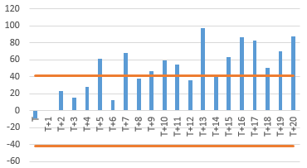
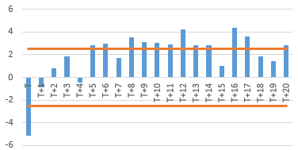
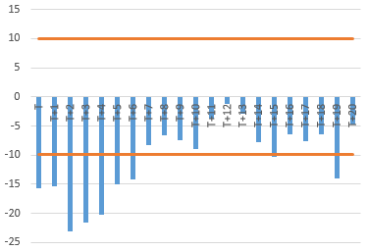
Result Residual Plot After First Intervention
South Korea
b=13, s=(1,2)
Taiwan
b=0, s=(1,5)
China
b=0 s=3, r=1

Slide 16
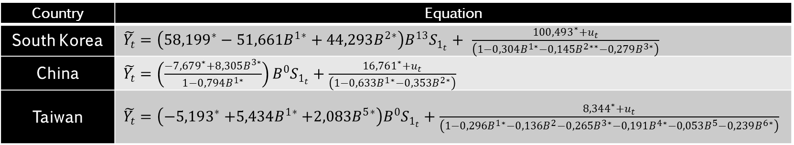
Result ARIMA First Intervention Model
Country | Equation
South Korea | $\tilde{Y_{t}}=\left(58,199^{∗}−{51,661B}^{1∗}+{44,293B}^{2∗}\right)B^{13}S_{1_{t}}+$ $\frac{100,493^{∗}+u_{t}}{\left(1−{0,304B}^{1∗}−{0,145B}^{2∗∗}−{0,279B}^{3∗}\right)}$
China | $\tilde{Y_{t}}=\left(\frac{−7,679^{∗}+8,305B^{3∗}}{1−0,794B^{1∗}}\right)B^{0}S_{1_{t}}+\frac{16,761^{∗}+u_{t}}{\left(1−{0,633B}^{1∗}−{0,353B}^{2∗}\right)}$
Taiwan | $\tilde{Y_{t}}=\left(−5,193^{∗}{+5,434B}^{1∗}+{2,083B}^{5∗}\right)B^{0}S_{1_{t}}+\frac{8,344^{∗}+u_{t}}{\left(1−{0,296B}^{1∗}−{0,136B}^{2}−{0,265B}^{3∗}−{0,191B}^{4∗}−{0,053B}^{5}−{0,239B}^{6∗}\right)}$
Country | Residual Independence |  |  |  |  | Normality
 | Ljung-Box Statistic |  |  |  |  | Shapiro-Wilk
 | Lag | 6 | 12 | 18 | 24
South Korea |  | 1.04** | 4.55** | 6.98** | 8.69** | 0.9952**
China |  | 2.84* | 6.76* | 21.29* | 28.18* | 0.9912*
Taiwan |  | . | 5.52** | 16.55** | 23.72** | 0.9906**
Note: * sig 5%, ** sig 10%

Slide 17
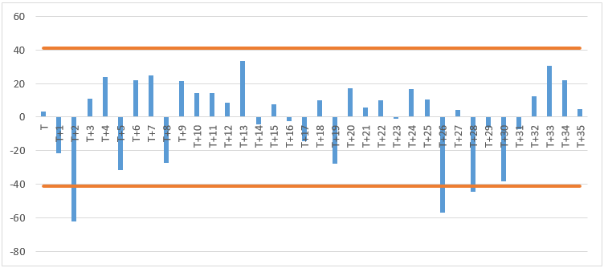
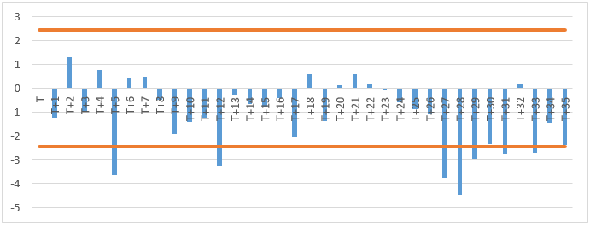
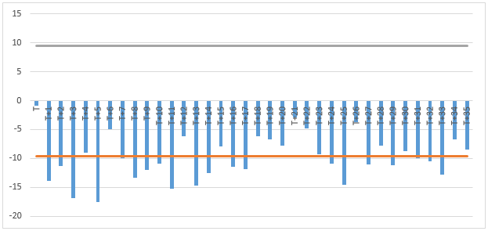
Result Residual Plot After Second Intervention
South Korea
b=2, s=1
Taiwan
b=5, s=(1,22.25)
China
b=1

Slide 18
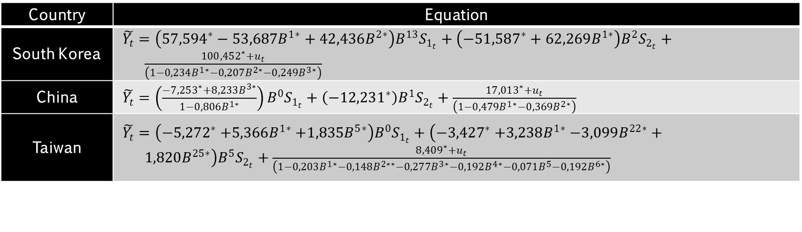
Result ARIMA Second Intervention Model
Country | Equation
South Korea | $\tilde{Y_{t}}=\left(57,594^{∗}−{53,687B}^{1∗}+{42,436B}^{2∗}\right)B^{13}S_{1_{t}}+\left(−51,587^{∗}+62,269B^{1∗}\right)B^{2}S_{2_{t}}+\frac{100,452^{∗}+u_{t}}{\left(1−{0,234B}^{1∗}−{0,207B}^{2∗}−{0,249B}^{3∗}\right)}$
China | $\tilde{Y_{t}}=\left(\frac{−7,253^{∗}+8,233B^{3∗}}{1−0,806B^{1∗}}\right)B^{0}S_{1_{t}}+\left(−12,231^{∗}\right)B^{1}S_{2_{t}}+\frac{17,013^{∗}+u_{t}}{\left(1−{0,479B}^{1∗}−{0,369B}^{2∗}\right)}$
Taiwan | $\tilde{Y_{t}}=\left(−5,272^{∗}{+5,366B}^{1∗}+{1,835B}^{5∗}\right)B^{0}S_{1_{t}}+\left(−3,427^{∗}{+3,238B}^{1∗}−3,099B^{22∗}+1,820B^{25∗}\right)B^{5}S_{2_{t}}+\frac{8,409^{∗}+u_{t}}{\left(1−{0,203B}^{1∗}−{0,148B}^{2∗∗}−{0,277B}^{3∗}−{0,192B}^{4∗}−{0,071B}^{5}−{0,192B}^{6∗}\right)}$
Country | Residual Independence |  |  |  |  | Normality
 | Ljung-Box Statistic |  |  |  |  | Shapiro-Wilk
 | Lag | 6 | 12 | 18 | 24
South Korea |  | 2.08** | 10.45** | 14.13** | 28.27** | 0.9947**
China |  | 3.69* | 6.56* | 16.92* | 21.76* | 0.9941*
Taiwan |  | . | 2.16** | 8.16** | 10.46** | 0.9881**
Note: * sig 5%, ** sig 10%

Slide 19
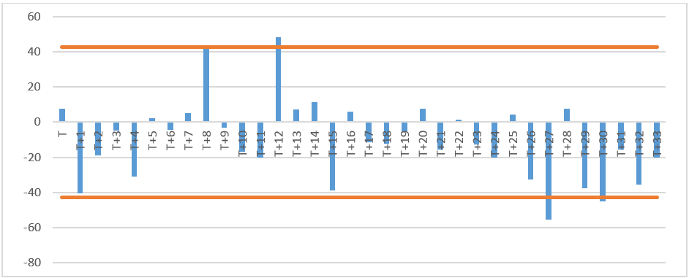
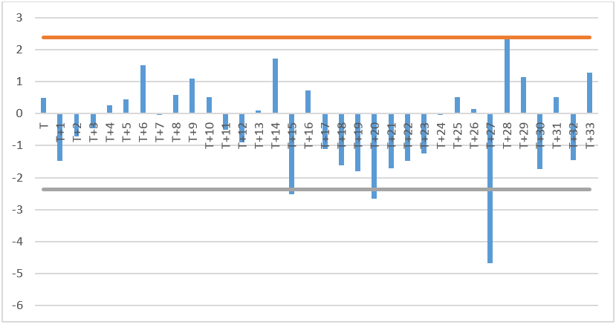
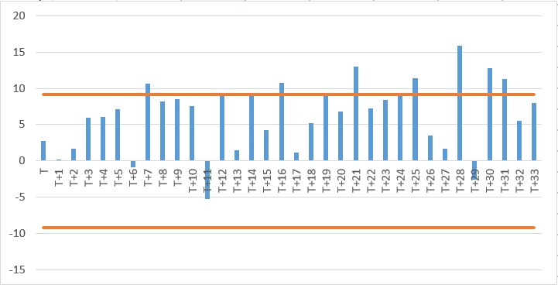
Result Residual Plot After Third Intervention
South Korea
b=12, s=1
Taiwan
b=27, s=1
China
b=28, s=(1,2)

Slide 20
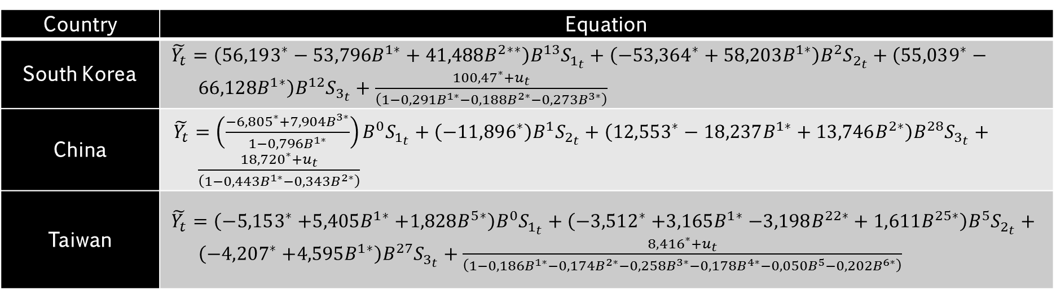
Result ARIMA Third Intervention Model / Final Model
Country | Equation
South Korea | $\tilde{Y_{t}}=\left(56,193^{∗}−{53,796B}^{1∗}+{41,488B}^{2∗∗}\right)B^{13}S_{1_{t}}+\left(−53,364^{∗}+58,203B^{1∗}\right)B^{2}S_{2_{t}}+\left(55,039^{∗}−{66,128B}^{1∗}\right)B^{12}S_{3_{t}}+\frac{100,47^{∗}+u_{t}}{\left(1−{0,291B}^{1∗}−{0,188B}^{2∗}−{0,273B}^{3∗}\right)}$
China | $\tilde{Y_{t}}=\left(\frac{−6,805^{∗}+7,904B^{3∗}}{1−0,796B^{1∗}}\right)B^{0}S_{1_{t}}+\left(−11,896^{∗}\right)B^{1}S_{2_{t}}+\left(12,553^{∗}−18,237B^{1∗}+13,746B^{2∗}\right)B^{28}S_{3_{t}}+\frac{18,720^{∗}+u_{t}}{\left(1−{0,443B}^{1∗}−{0,343B}^{2∗}\right)}$
Taiwan | $\tilde{Y_{t}}=\left(−5,153^{∗}{+5,405B}^{1∗}+{1,828B}^{5∗}\right)B^{0}S_{1_{t}}+\left(−3,512^{∗}{+3,165B}^{1∗}−3,198B^{22∗}+1,611B^{25∗}\right)B^{5}S_{2_{t}}+\left(−4,207^{∗}{+4,595B}^{1∗}\right)B^{27}S_{3_{t}}+\frac{8,416^{∗}+u_{t}}{\left(1−{0,186B}^{1∗}−{0,174B}^{2∗}−{0,258B}^{3∗}−{0,178B}^{4∗}−{0,050B}^{5}−{0,202B}^{6∗}\right)}$
Country | Residual Independence |  |  |  |  | Normality
 | Ljung-Box Statistic |  |  |  |  | Shapiro-Wilk
 | Lag | 6 | 12 | 18 | 24
South Korea |  | 0.93** | 12.81** | 16.03** | 23.62** | 0.9963**
China |  | 6.13* | 7.81* | 16.17* | 20.28* | 0.9923*
Taiwan |  | . | 3.06** | 9.51** | 12.89** | 0.9906**
Note: * sig 5%, ** sig 10%

Slide 21
Result The Impact of First Intervention
Country | t | Period | Final Intervention | ARIMA Pre-Intervention | Impact Magnitude | Percentage
South Korea | T₁+13 T₁+14 T₁+15 | July 2012 August 2012 September 2012 | 35,443.371 17,043.355 27,857.179 | 9,170.629 9,121.912 9,082.09 | 26,272.742 79,21.443 18,775.089 | 286.49% 86.84% 206.73%
China | T₁ T₁+3 T₁+4 | June 2011 September 2011 October 2011 | 9,847.362 2,715.161 3,028.045 | 26,597.663 25,625.351 24,528.393 | -16,750.301 -22,910.189 -21,500.348 | -62.98% -89.40% -87.65%
Taiwan | T₁ T₁+1 T₁+5 | June 2011 July 2011 November 2011 | 583.762 10,953.514 14,748.841 | 10,762.480 9,835.426 5,639.683 | -10,178.718 1,118.089 9,109.158 | -94.58% 11.37% 161.52%
Act of anticipation towards import duties in the future (Wan, Sun, Grebner, 2010)

Slide 22
Result The Impact of Second Intervention
Country | t | Period | Final Intervention | ARIMA First Intervention | Impact Magnitude | Percentage
South Korea | T₂+2 T₂+3 | May 2013 April 2013 | 10,861.767 24,488.713 | 27,109.524 25,504.441 | -16,247.757 -1,015.728 | -59.93% -3.98%
China | T₂+1 | April 2013 | 626.414 | 5,892.451 | -5,266.037 | -89.37%
Taiwan | T₂+5 T₂+6 T₂+27 T₂+30 | August 2013 September 2013 June 2015 July 2015 | 2,275.529 10,233.212 1,970.493 5,125.159 | 11,657.246 11,550.363 12,966.918 12,947.487 | -9,381.717 -1,317.151 -10,996.424 -7,822.328 | -80.48% -11.40% -84.80% -60.42%

Slide 23
Result The Impact of Third Intervention
Country | t | Period | Final Intervention | ARIMA Second Intervention | Impact Magnitude | Percentage
South Korea | T₃+12 T₃+13 | March 2017 April 2017 | 38,358.593 16,344.625 | 25,025.658 24,987.674 | 13,332.935 -8,643.048 | 53.28% -34.59%
China | T₃+28 T₃+29 T₃+30 | July 2018 August 2018 September 2018 | 9,775.349 234.299 5,972.488 | 702.993 701.435 700.020 | 9,072.356 -467.136 5,272.468 | 1,290.54% -66.60% 753.19%
Taiwan | T₃+27 T₃+28 | June 2018 July 2018 | 578.648 8528.2 | 6,246.916 6,248.321 | -5,668.268 2,279.879 | -90.74% 36.49%
Decline in Taiwan steel export market (Global Steel Trade Monitor, 2019)

Slide 24
Conclusion
Investigations by KADI have not been able to reduce the volume of CRC/S import. Imports from South Korea increased by more than 100%, but imports from China and Taiwan decreased by around -62% and -94%.
The application of anti-dumping policy is proven to be able to reduce the volume of CRC/S import. The decline in the three countries reached -59% to -89%.
The anti-dumping policy that is no longer applied has an impact on increasing imports from China and South Korea by more than 100% and 53%. Meanwhile, imports from Taiwan continued to decline by -90% and only increased the following month.

Slide 25
Analysis of Anti-Dumping Policy on Steel Imports Using Multi-Input ARIMA Intervention Model
Authors:
Prisita Nallavasthi
Siskarossa Ika Oktora
Politeknik Statistika STIS, Jakarta

